Slide 1
Chapter 08 Preliminary of Projective Geometry
Prof. Lin ZHANG
School of Computer Science and Technology
Tongji University

Slide 2
Outline
Vector Operations
Fundamentals of Projective Geometry

Slide 3
Vector operations
Vector representation
Length (or norm) of a vector
Normalized vector (unit vector)
We say if and only if

Slide 4
Vector operations
if
then
Dot product (inner product)
Laws of dot product:
Theorem
(why?)

Slide 5
Vector operations
Cross product

Slide 6
Vector operations
Cross product
is also a vector, whose direction is determined by the right-hand law and
represents the oriented area of the parallelogram taking and as two sides
(easy to prove)
(why?)

Slide 7
Vector operations
Cross product
Theorem
(why?)
Theorem
they are not equal to zero at the same time, and
(easy to understand)
Property

Slide 8
Vector operations
Cross product
Definition
Suppose
Then,

Slide 9
Vector operations
Mixed product (scalar triple product or box product)
Geometric Interpretation: it is the (signed) volume of the parallelepiped defined by the three vectors given

Slide 10
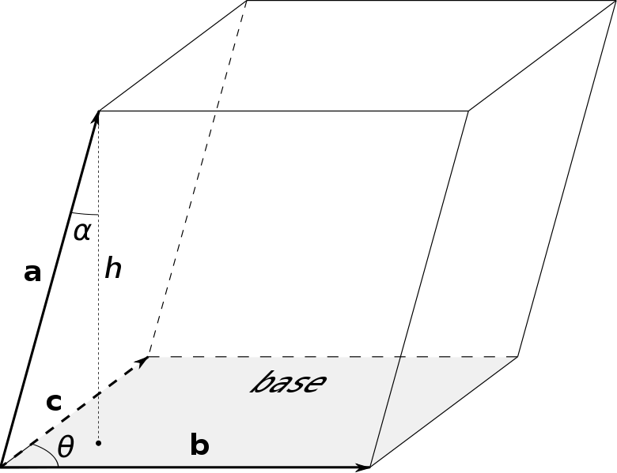
Vector operations
Mixed product (scalar triple product or box product)
Base
h
b
a

Slide 11

Vector operations
Mixed product (scalar triple product or box product)
Property:
why?

Slide 12
Vector operations
Mixed product (scalar triple product or box product)
Theorem
why?
are coplanar
are coplanar
they are not equal to zero at the same time, and

Slide 13
Outline
Vector Operations
Fundamentals of Projective Geometry

Slide 14
Foundations of Projective Geometry
What is homogeneous coordinate?
For a normal point on a plane ,
its homogenous coordinate is where k can be any non-zero real number
Homogenous coordinate for a point is not unique
For a homogenous coordinate (normal point)
we can rewrite it as
normalized homogenous coordinate

Slide 15
Foundations of Projective Geometry
What is homogeneous coordinate?
For a normal point on a plane ,
its homogenous coordinate is where k can be any non-zero real number
Converting from homogenous coordinate (normal point) to inhomogeneous coordinate,

Slide 16
Foundations of Projective Geometry
What is homogeneous coordinate?
Geometric interpretation
In plane , in the 2D frame
, one point
Coordinate of any point (except O) on line Om in the frame is the homogeneous coordinate of m
1
These points can be represented as

Slide 17
Foundations of Projective Geometry
What is homogeneous coordinate?
Geometric interpretation
In plane , in the 2D frame
, one point
Coordinate of any point (except O) on line Om in the frame is the homogeneous coordinate of m
1
These points can be represented as
How about a line passing through O and parallel to ?

Slide 18
Foundations of Projective Geometry
What is homogeneous coordinate?
Geometric interpretation
How about a line passing through O and parallel to ?
Consider a line passing through O and m(x₀, y₀, 0)^{T}
1
We define: it meets at an infinity point, and also the homogeneous coordinate of such a point can be represented as points on Om
So, the infinity point has the form (kx₀, ky₀, 0)^{T}

Slide 19
Foundations of Projective Geometry
What is homogeneous coordinate?
Normal case:
abnormal case:
line k (x₀, y₀, 1) (k!=0)
line (kx₀, ky₀, 0) (k!=0)
make an analogy
a normal point (x₀, y₀) on the plane
Define: it meets at an infinity point
The homogeneous coordinate of this normal point is k(x₀, y₀ ,1)
The homogeneous coordinate of this infinity point is k(x₀, y₀ ,0)

Slide 20
Foundations of Projective Geometry
What is homogeneous coordinate?
Geometric interpretation
How about a line passing through O and parallel to ?
One infinity point determines an orientation
1
We define: all infinity points on comprise an infinity line
In fact, plane meets at the infinity line
Notes:
注意：这是平面几何，（x,y,z）是齐次坐标而已，不是三维空间上的。我们这个例子上的所有几何元素都是定义在pi0上的，所以无穷远直线也是定义在pi0上的，z=0是它的齐次坐标方程，z跟三维空间没关系。Z=0这个无穷远直线方程可以通过其定义求出来：两个无穷远点定义了无穷远直线,(x1,y1,0) cross product (x2,y2,0)

Slide 21
Foundations of Projective Geometry
+ infinity line = Projective plane
In fact, any Euclidean space can be extended to a projective space by
An Euclidean plane
Properties of a projective plane
Two points determine a line; two lines determine a point (the second claim is not correct in the normal Euclidean plane)
Two parallel lines intersect at an infinity point; that means one infinity point corresponds to a specific orientation
Two parallel planes intersect at the infinity line
Properties of a 3D projective space
All properties on 2D projective plane can be kept
More on infinities
On 2-D projective plane, all infinity points form an infinity line; in 3-D projective space, all infinity points form an infinity plane; or in other words, all infinity lines form an infinity plane

Slide 22
Foundations of Projective Geometry
Lines in the homogeneous coordinate
On a projective plane, please determine the line passing two points
determine two lines
xx’ actually is the intersection between oxx’ and
1

Slide 23
Foundations of Projective Geometry
Lines in the homogeneous coordinate
On a projective plane, please determine the line passing two points
Thus, locates on xx’
resides on the plane oxx’
1
are coplanar

Slide 24
Foundations of Projective Geometry
Lines in the homogeneous coordinate
On a projective plane, please determine the line passing two points
Homogeneous coordinate of the line
Homogeneous coordinate of the infinity line is (0,0,1)^{T}

Slide 25
Foundations of Projective Geometry
Lines in the homogeneous coordinate
On a projective plane, please determine the line passing two points
Theorem
On the projective plane, the line passing two points is

Slide 26
Foundations of Projective Geometry
Lines in the homogeneous coordinate
A point is on the line
(It is )

Slide 27
Foundations of Projective Geometry
Lines in the homogeneous coordinate
Theorem: On the projective plane, the intersection of two lines is the point
Proof:
Two lines
Inhomogeneous form

Slide 28
Foundations of Projective Geometry
Lines in the homogeneous coordinate
Theorem: On the projective plane, the intersection of two lines is the point
Homogenous form of the cross point is
let

Slide 29
Foundations of Projective Geometry
Lines in the homogeneous coordinate
Theorem: On the projective plane, the intersection of two lines is the point
Example: find the cross point of the lines
Homogeneous form
Homogeneous coordinates of the two lines are
Cross point is

Slide 30
Foundations of Projective Geometry
Lines in the homogeneous coordinate
Theorem: On the projective plane, the intersection of two lines is the point
Example: find the cross point of the lines
Homogeneous form
Homogeneous coordinates of the two lines are
Cross point is

Slide 31
Foundations of Projective Geometry
Duality
In projective geometry, lines and points can swap their positions
How to interpret?
If x is a variable, it represents the points lying on the line l;
If l is a variable, it represents the lines passing a fixed point x
The line passing two points is
The cross point of two lines is
Duality Principle: To any theorem of projective geometry, there corresponds a dual theorem, which may be derived by interchanging the roles of points and lines in the original theorem

Slide 32
More results you need to be familiar
A set of parallel lines intersect at the same infinity point
The homogeneous coordinate of the infinity line is
The infinity point of a line can be identified as its intersection with the infinity line. E.g, on a projective plane, the infinity point of the X-axis is
In 3D projective space, the infinity plane are composed of points of the form ; You can also consider that the infinity plane comprises all the possible directions in 3D space
(Note: since the infinity point actually represents a direction, usually it is represented as a norm vector, for example (1, 0, 0)
Notes:
两个无穷远点确定无穷远直线（x1,y1,0）,(x2.y2,0)，然后按照cross product计算所形成的直线。X-axis（y=0）的线坐标（0,1,0）,无穷远直线的线座标（0,0,1），计算叉乘

Slide 33
More results you need to be familiar
Projective transformation
are two projective planes, is a matrix
We say can be projectively transformed to each other and H is the projective transformation matrix between them. For the 2-D case, H is also called as homography
Note 1: If π₀ can be projectively transformed to π₁, the projective transformation from π₀ to π₁ is unique up to a scale factor
Note 2: The above definition is for 2D case. It can be straightforwardly extended to other dimensions

Slide 34
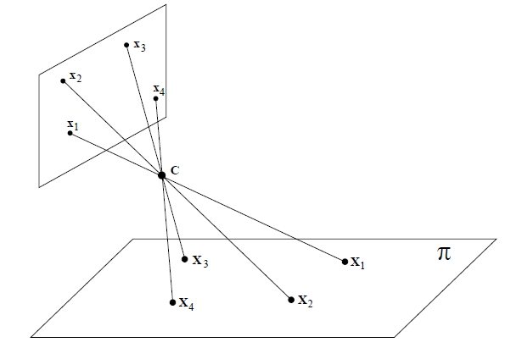
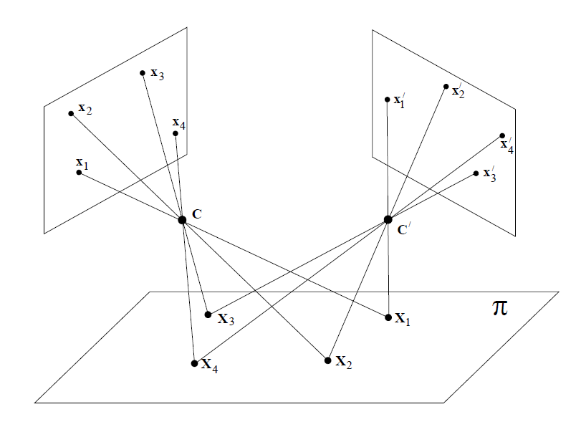
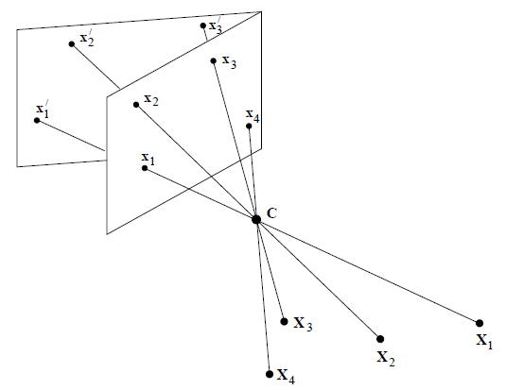
More results you need to be familiar
Projective transformation (typical examples in CV)

Slide 35


